Slide 1
Sysdig Overview
Sam Gabrail – Sr. Sales Engineer

Slide 2

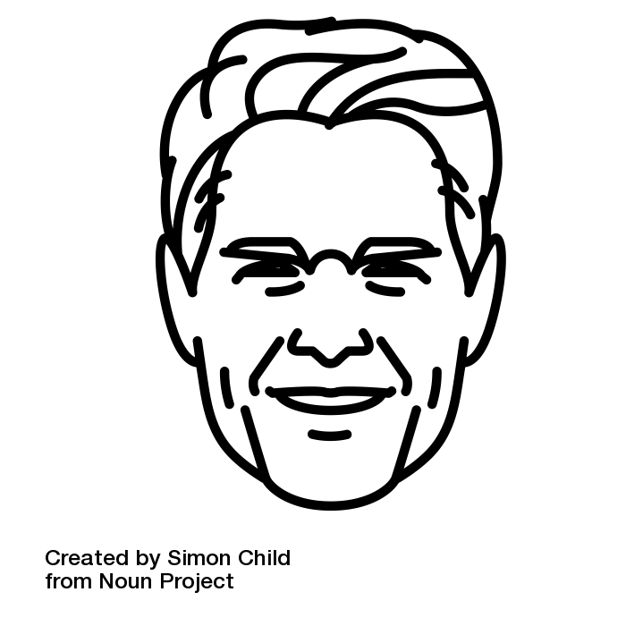
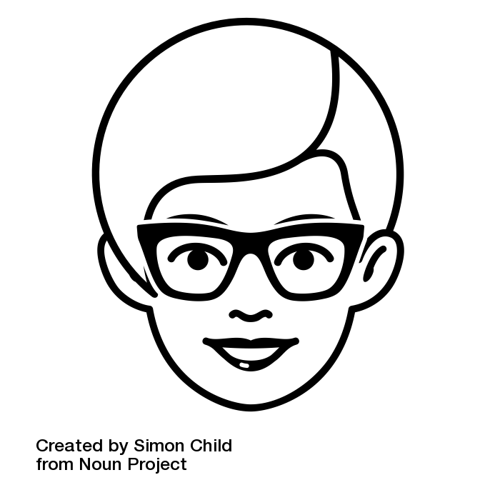
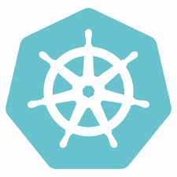

Cloud-native architectures benefit the business + empower developers.
Business leaders
Developer
Microservices
Kubernetes
Innovation pace
Cost efficiency
Risk mitigation
Infrastructure agnostic
Independent teams
Reusable components
Cloud

Slide 3

But when you move to cloud-native
your legacy visibility + security tools will leave you blind.

Slide 4

Legacy tools are blinded by the radical changes in cloud-native architecture.
Your existing
operational infrastructure
The shift to cloud-native
The challenge of cloud-native
SIEM
Firewall
IDS
Vulnerability
Management
Monitoring
APM
Capacity planning
Containers abstract away typical visibility points
Microservices
Microservices give you 10x more elements to understand & protect
Kubernetes
Multi-cloud makes consistent security + monitoring a new challenge
Cloud

Slide 5
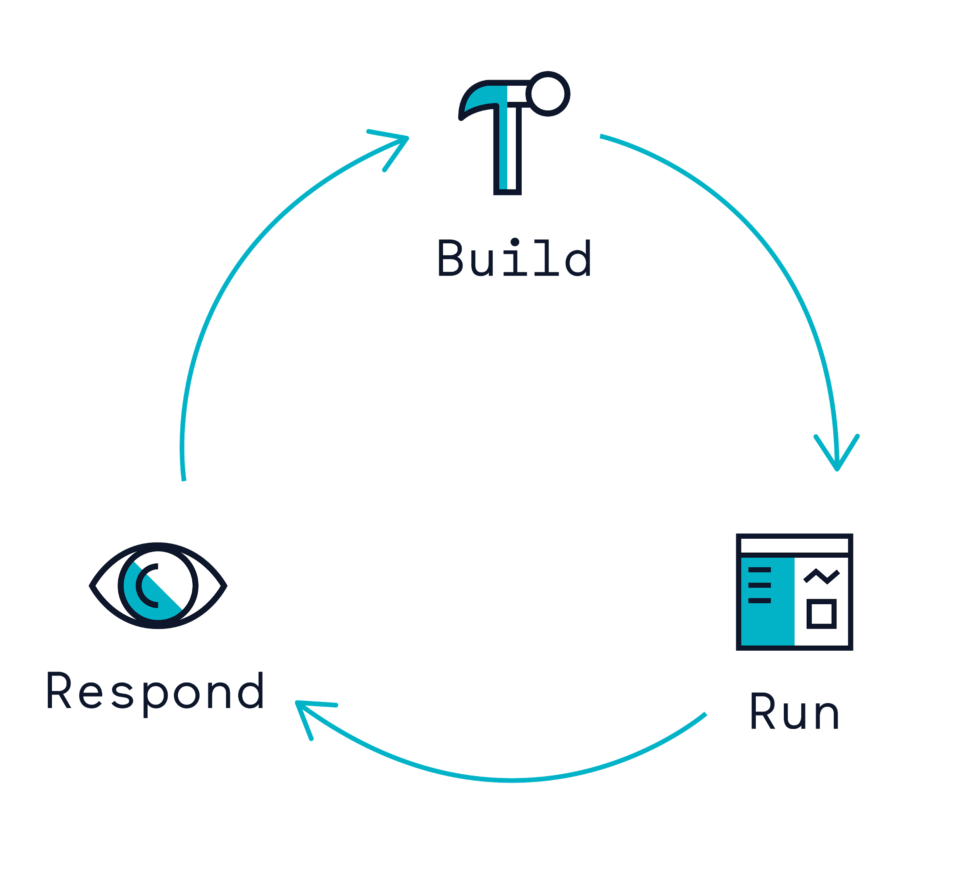
The cloud-native visibility gap.
How can I scan + block vulnerable images + enforce best practices pre-production early in CI/CD?
How can I block threats, enforce compliance and monitor app performance from millions of containers & thousands of services?
Cloud-native architectures simplify development while increasing operations complexity.
How can I proactively alert on incidents, reduce MTTR with forensics, and capture detailed audit records when containers are ephemeral?

Slide 6
Addressing a broad set of use cases.
Sysdig is the first cloud-native visibility + security platform to eliminate the need for stand-alone niche tools like container security and monitoring.
Scan + block CVEs
Enforce DevOps best practices
Plan capacity + growth
Visualize service topology
Monitor health + compliance
Capture forensics & audit records
Block zero-day threats
Reduce MTTR

Slide 7
How can Sysdig address the cloud visibility gap?

Slide 8


We began with a dream.
Q: In a multi-cloud world with opaque containers and no network boundaries how do we recreate the magic of network packets?
– Loris Degioanni Sysdig Founder + Wireshark Co-Creator

Slide 9






A new way to gain deep insights.
CONTAINER
APPLICATION
MICROSERVICE
FILES
HOSTS
The kernel never lies:
A data source as rich as logs, but real-time!
HOST / OS KERNEL

Slide 10



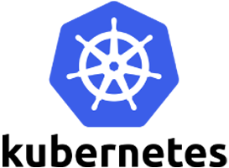


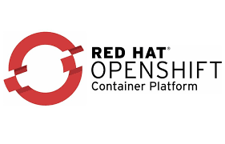


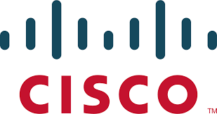


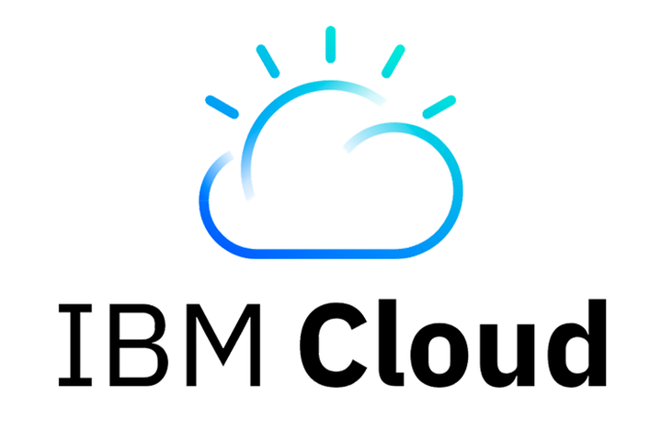
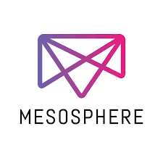
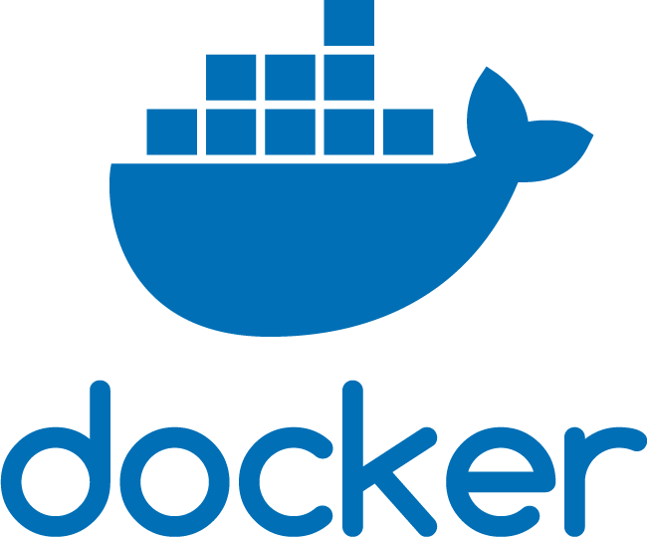
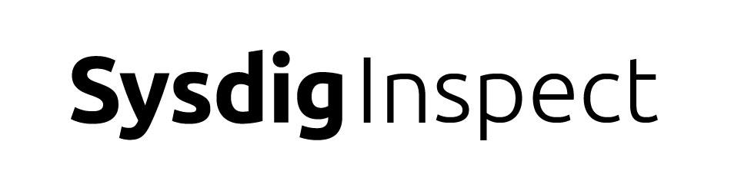


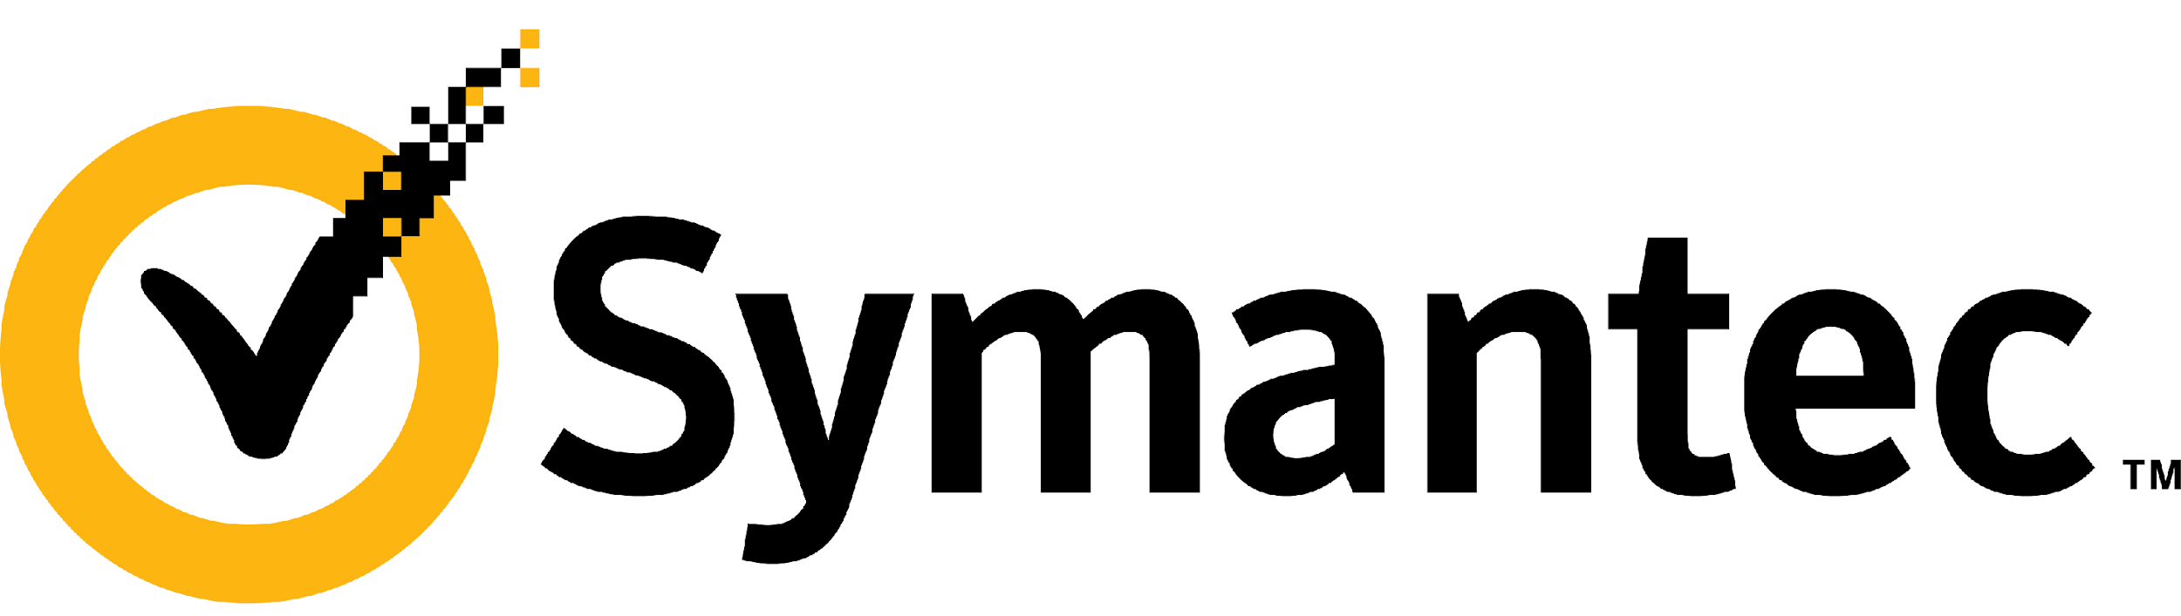

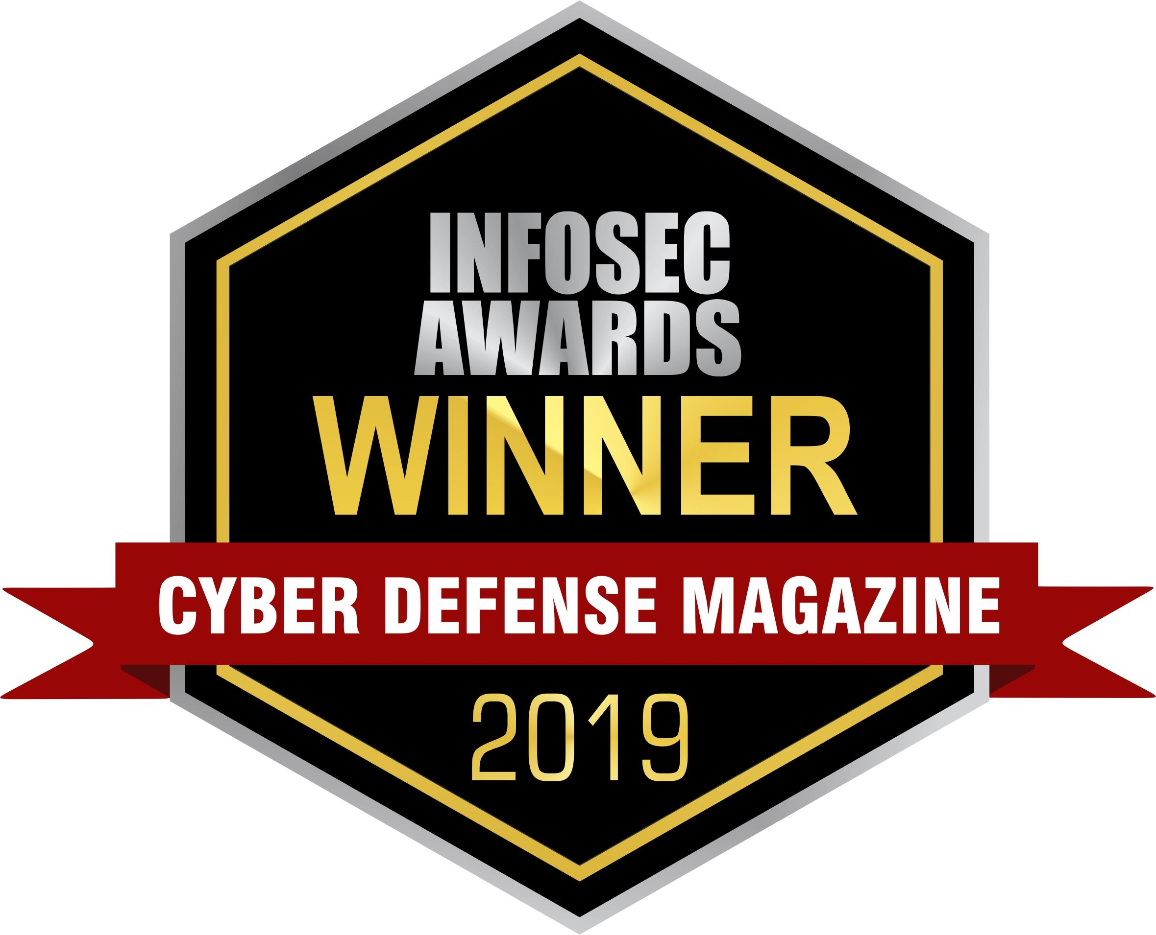
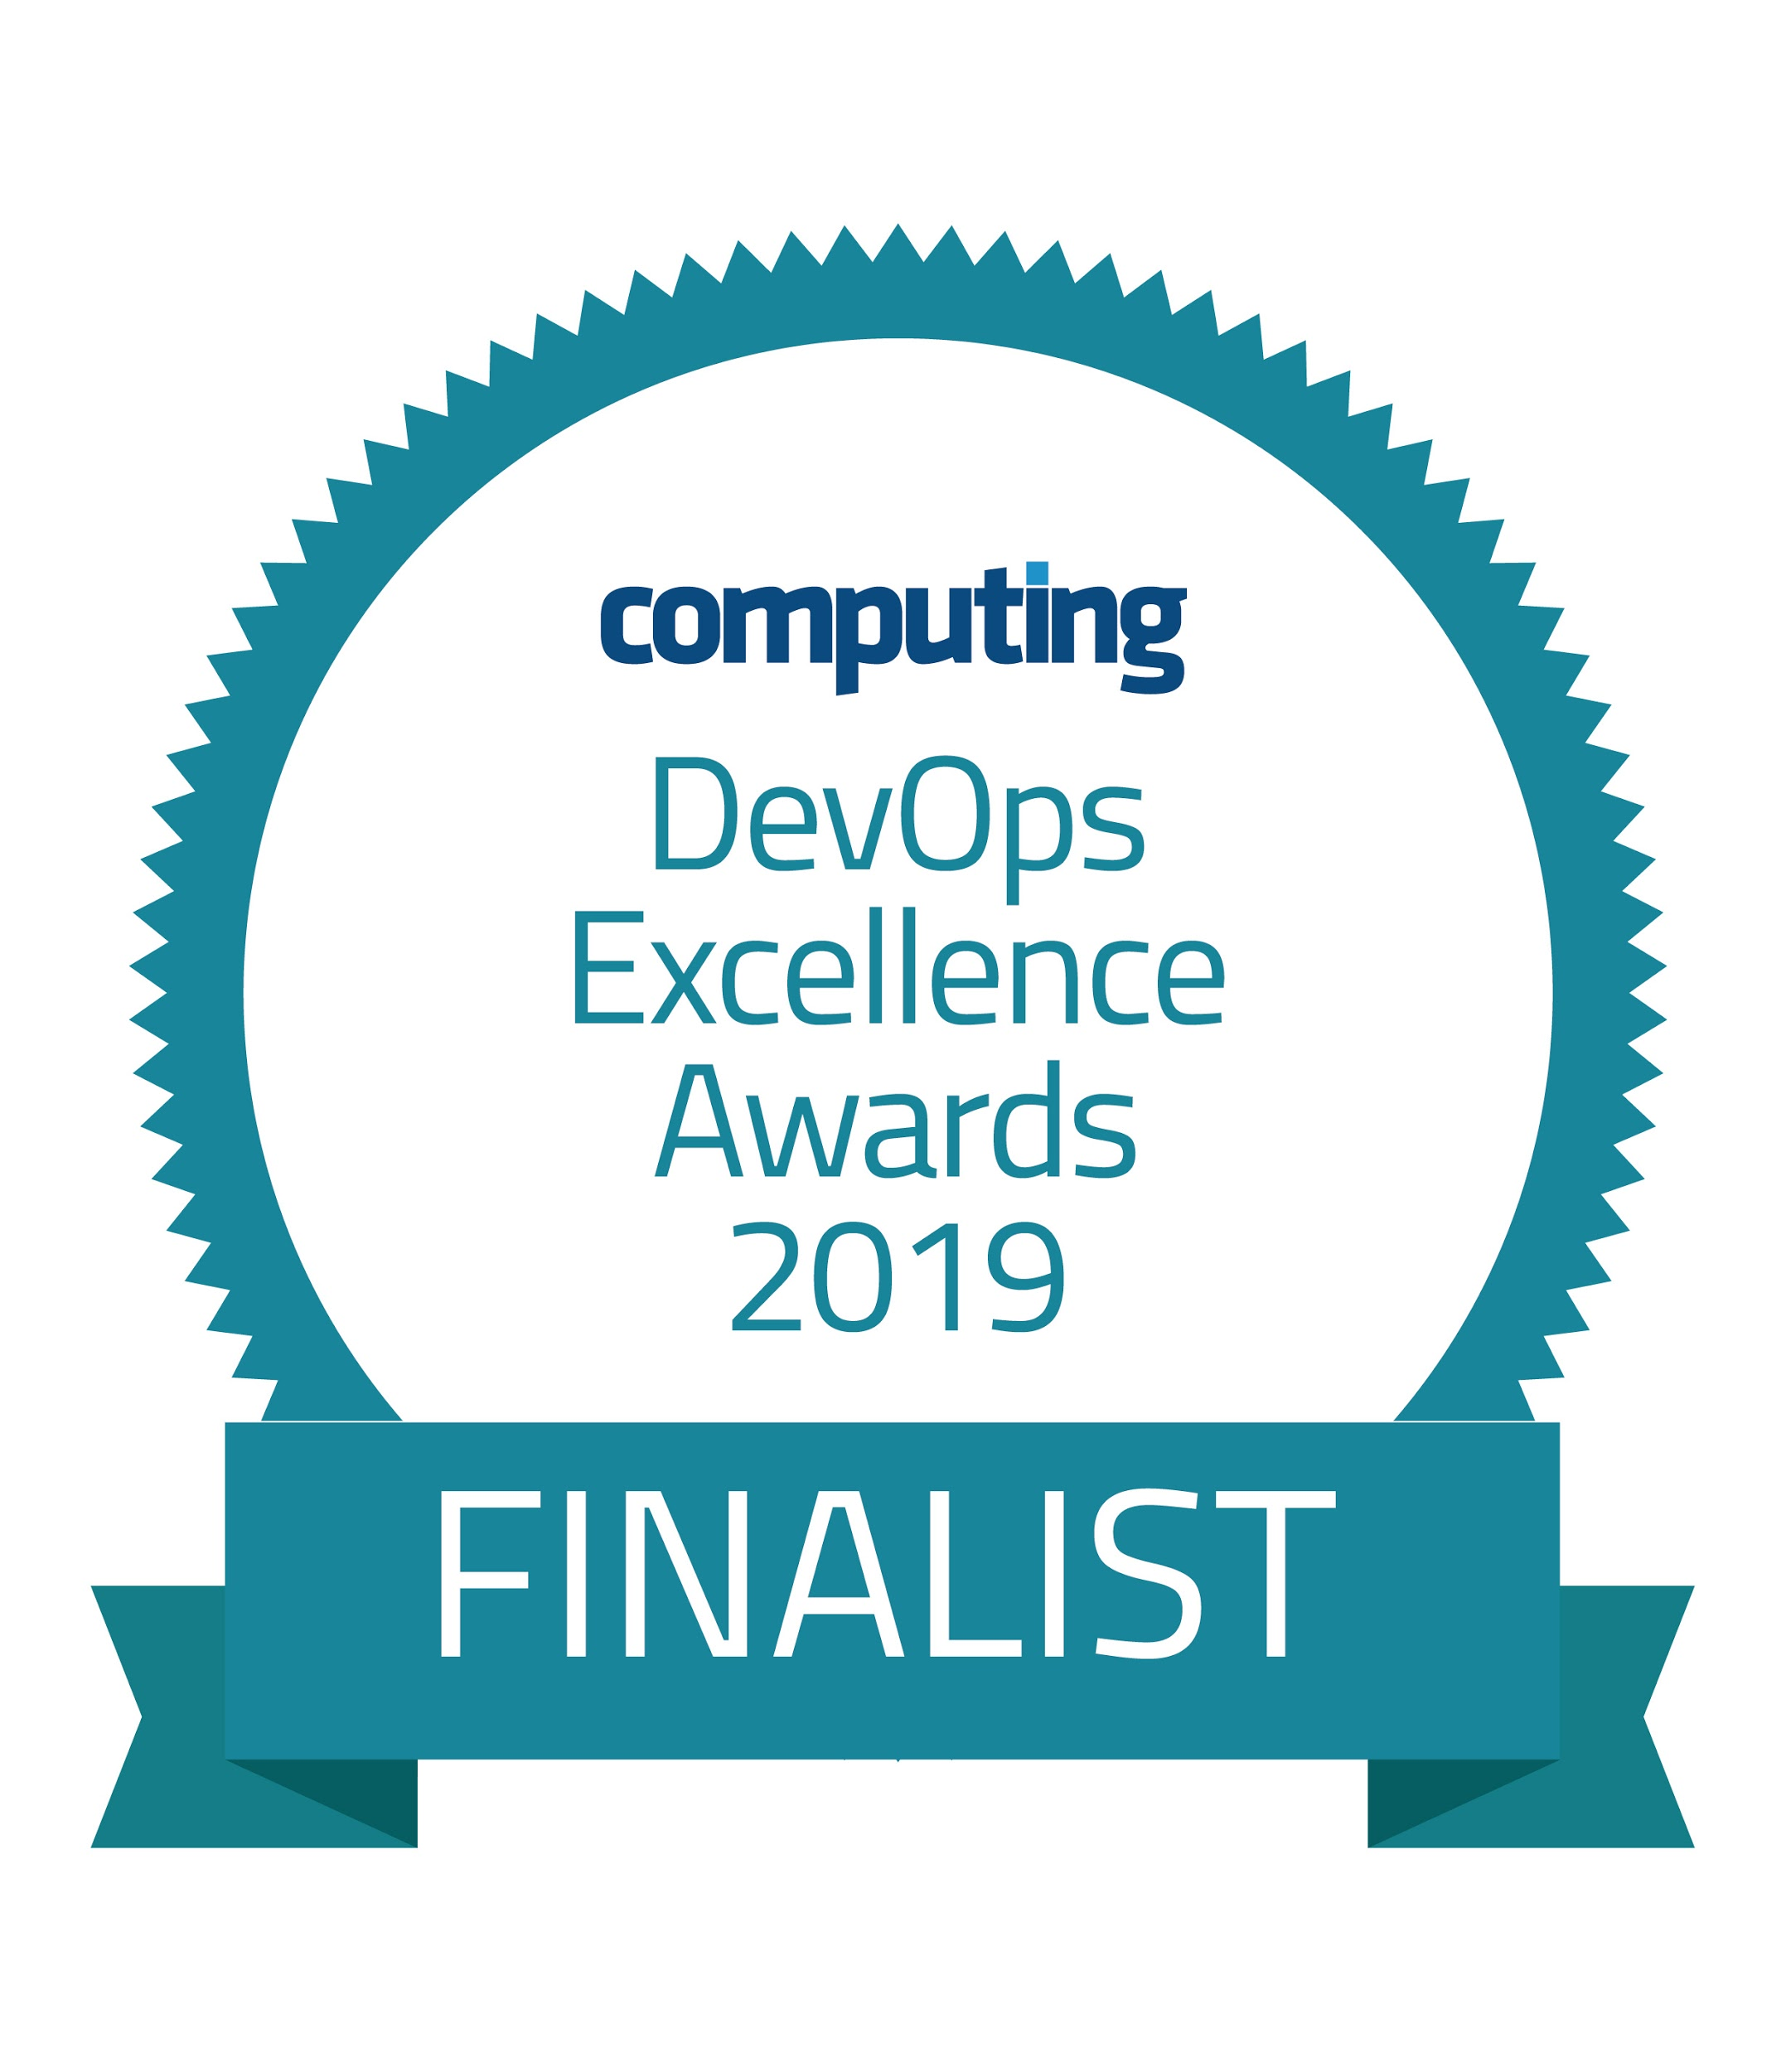
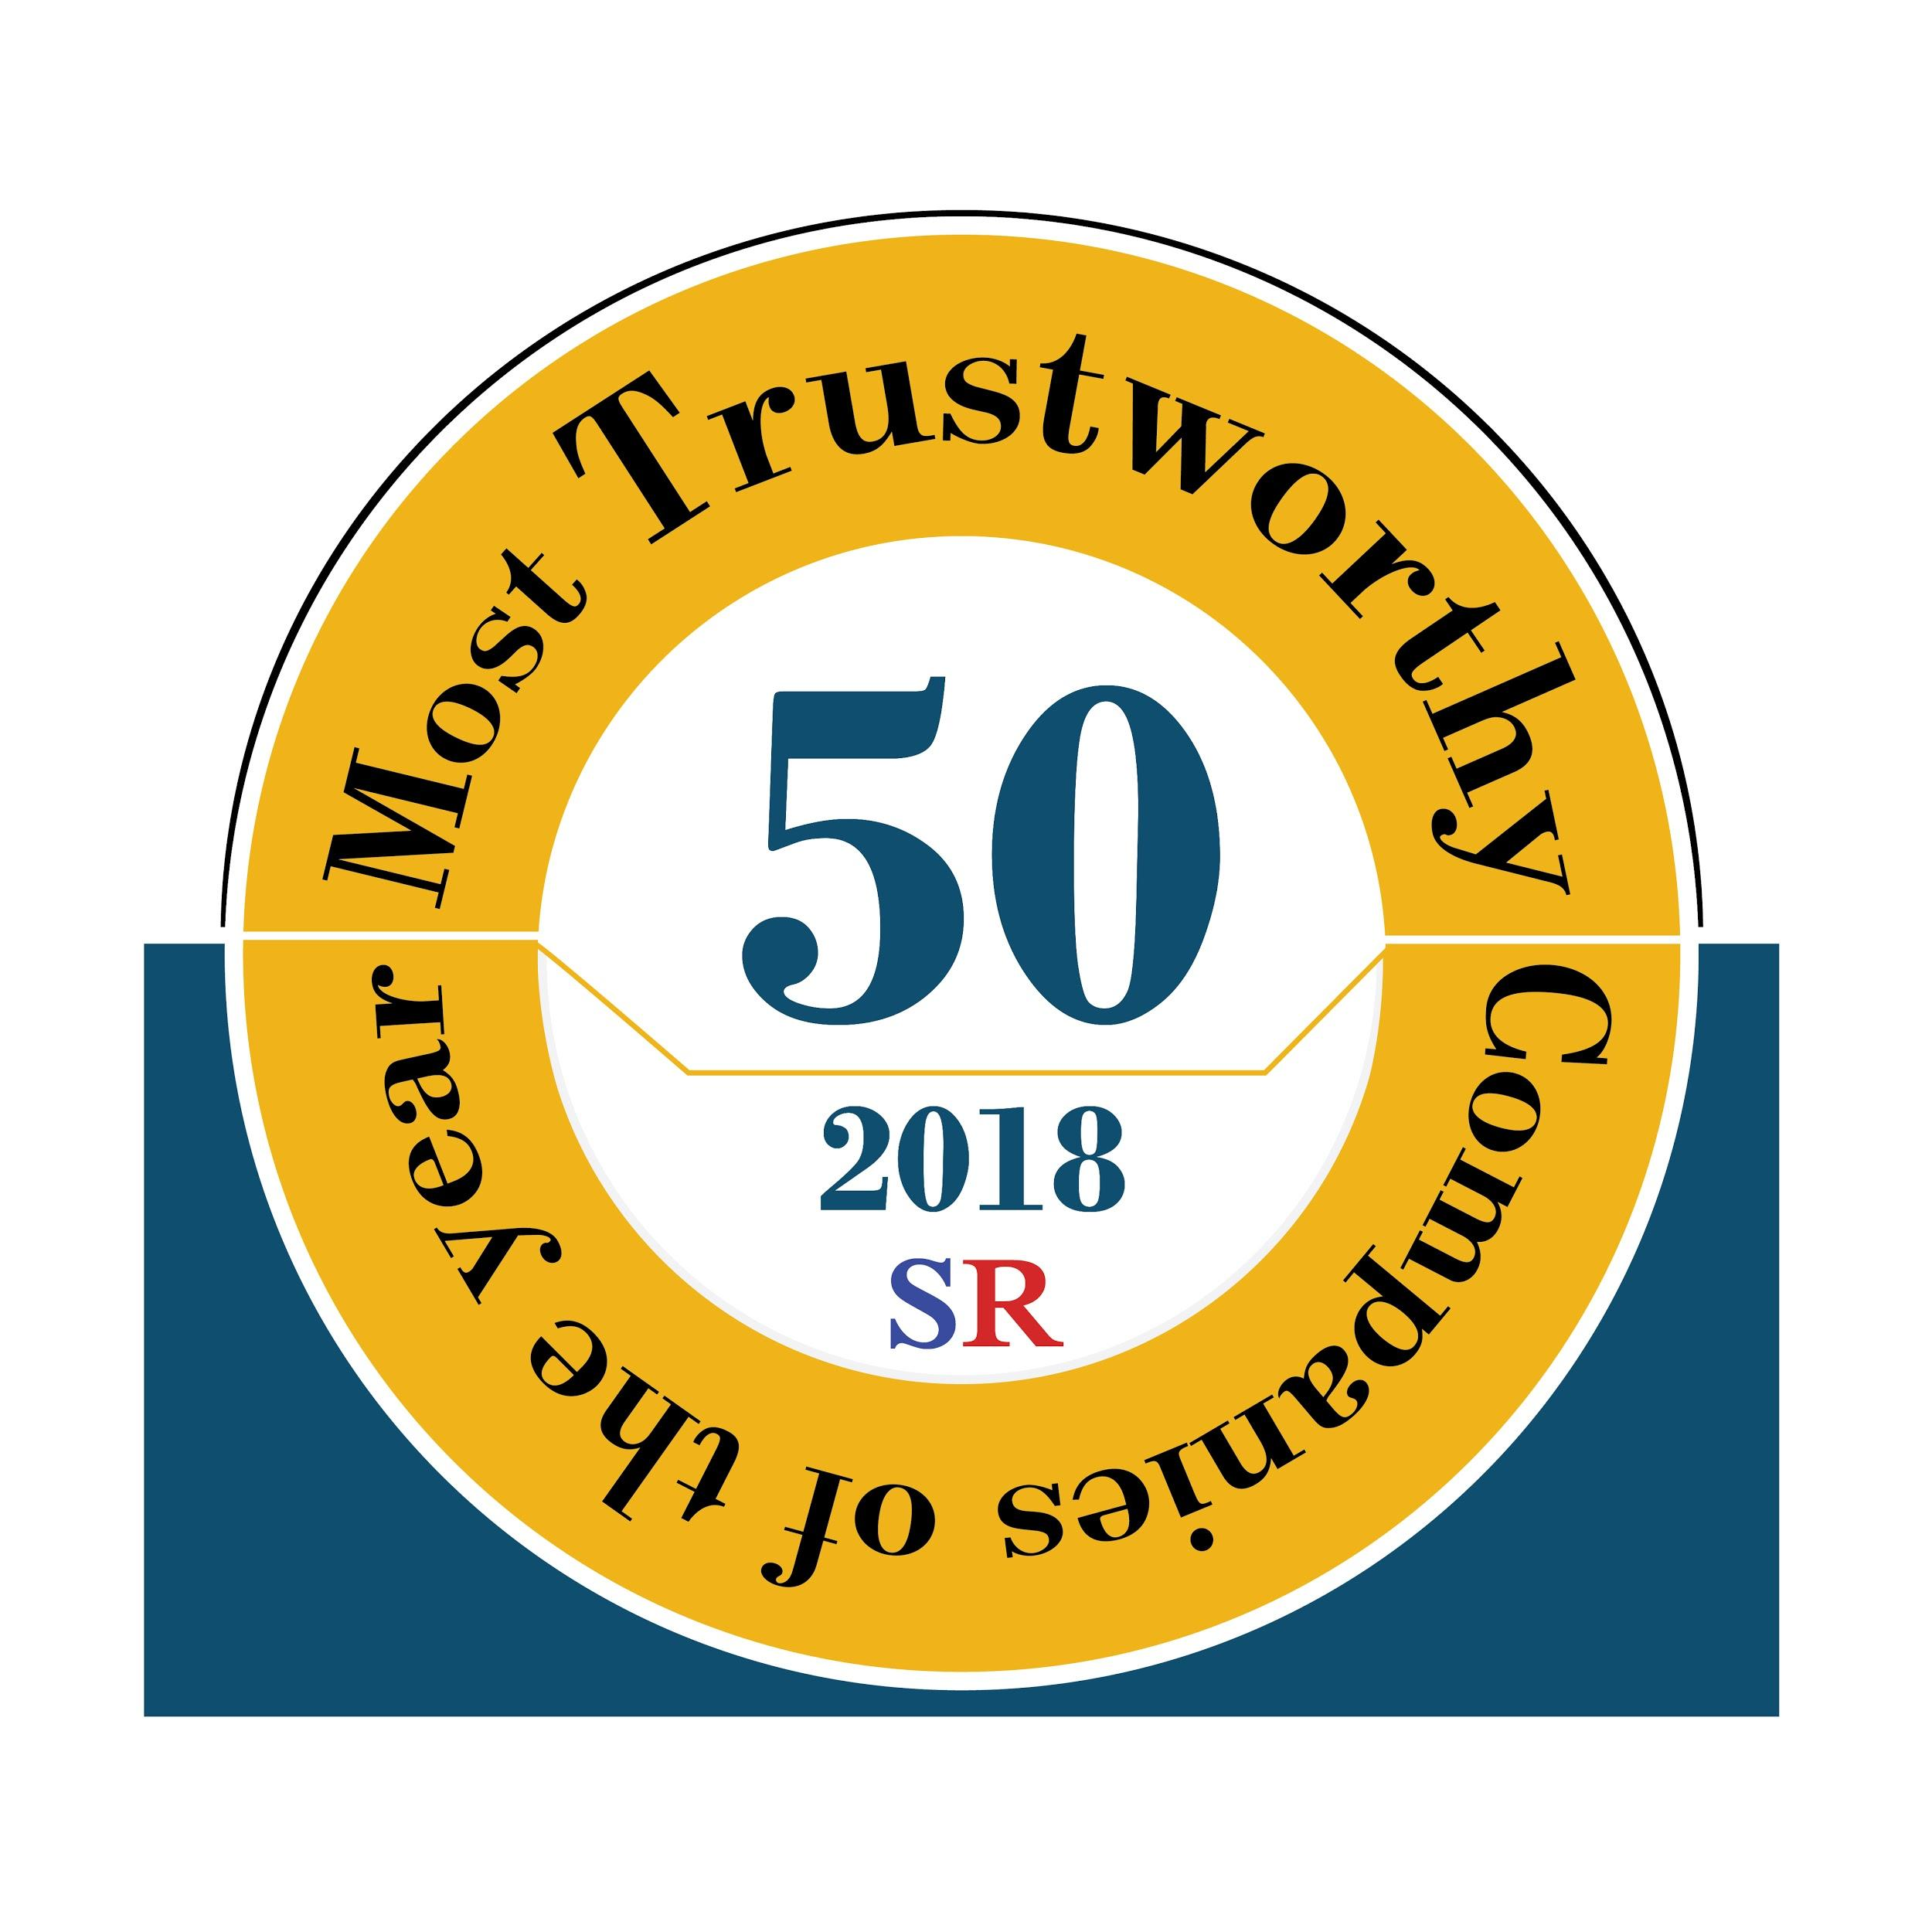
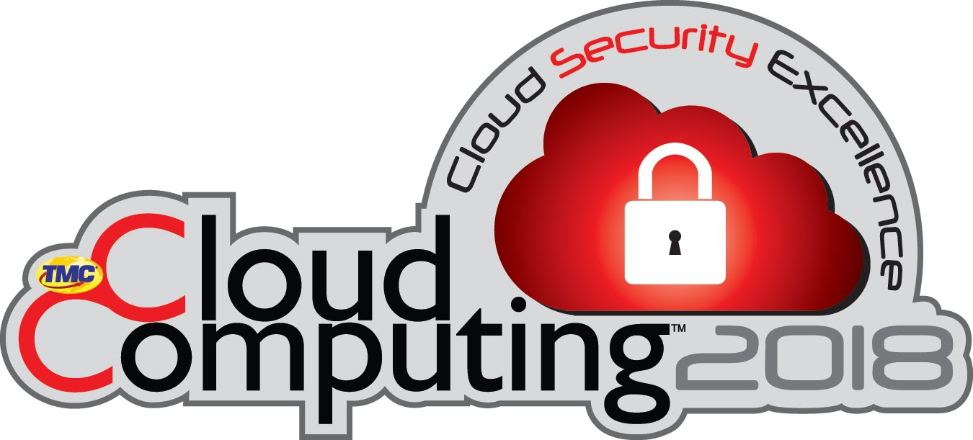
MISSION: Enable enterprises to operate reliable + secure cloud-native applications.
INTRODUCING SYSDIG
Open Core Innovation
Enterprise Customer Base
Strong Ecosystem
Company Momentum

Slide 11
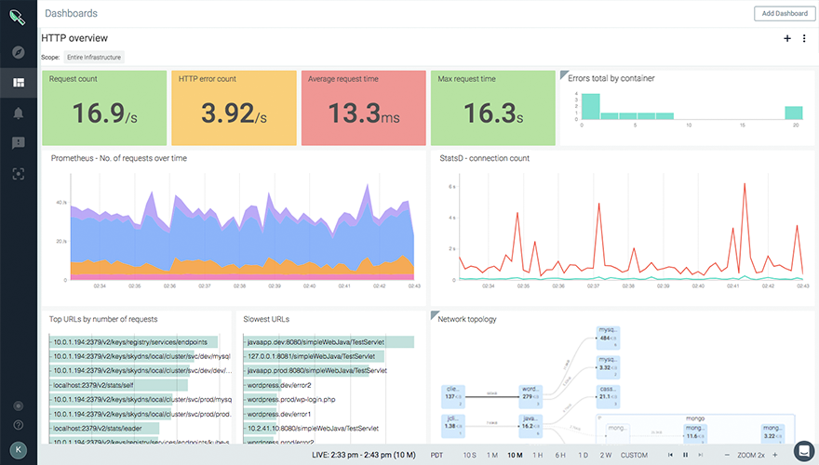
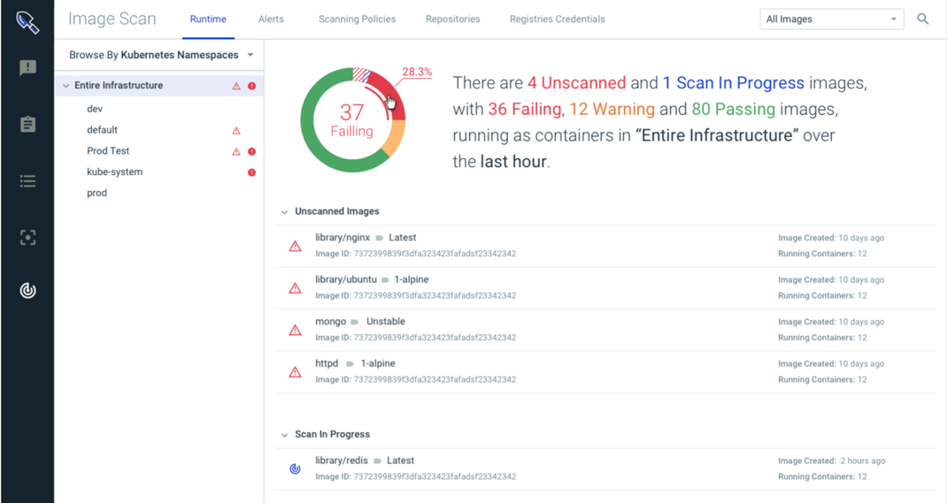





Enterprise grade offerings built on an open core.
SYSDIG MONITOR
SYSDIG SECURE
PROMETHEUS
SYSDIG INSPECT
FALCO
ANCHORE

Slide 12
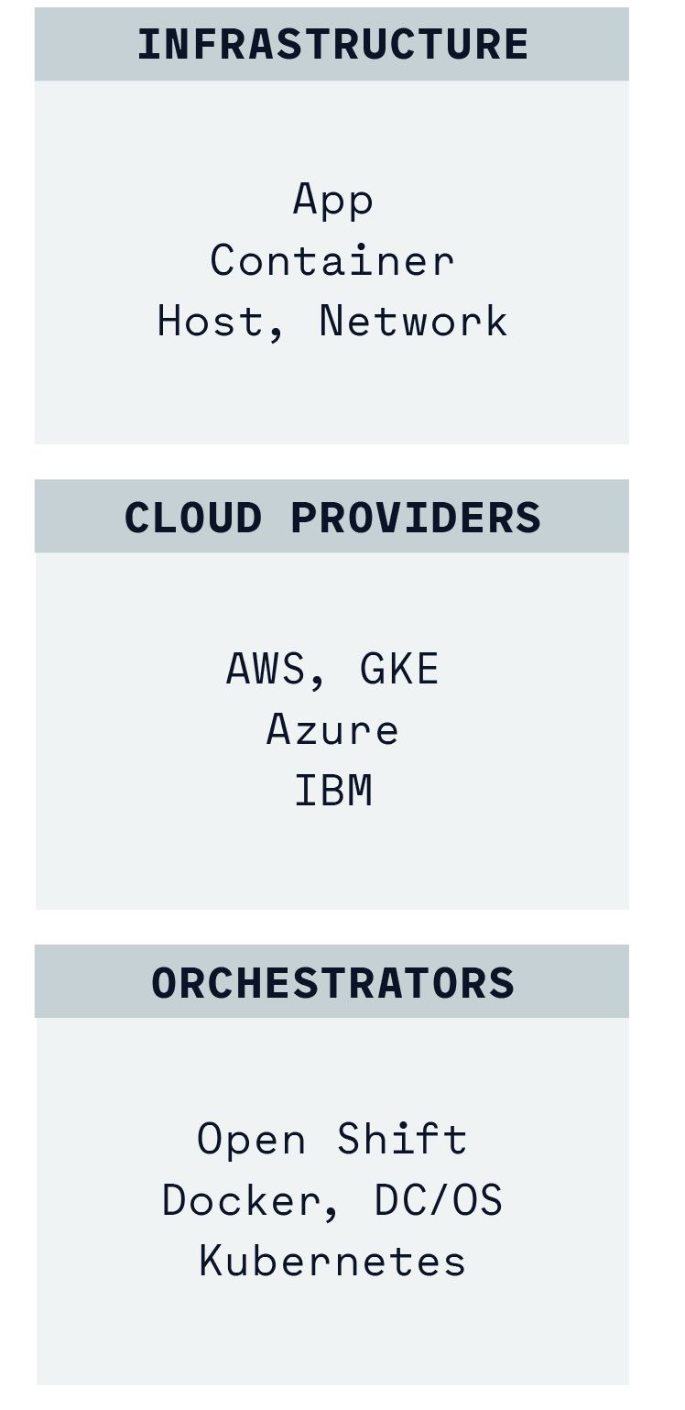
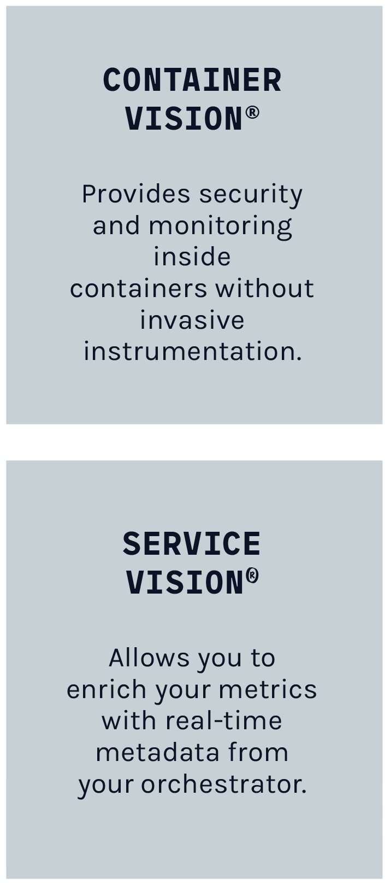
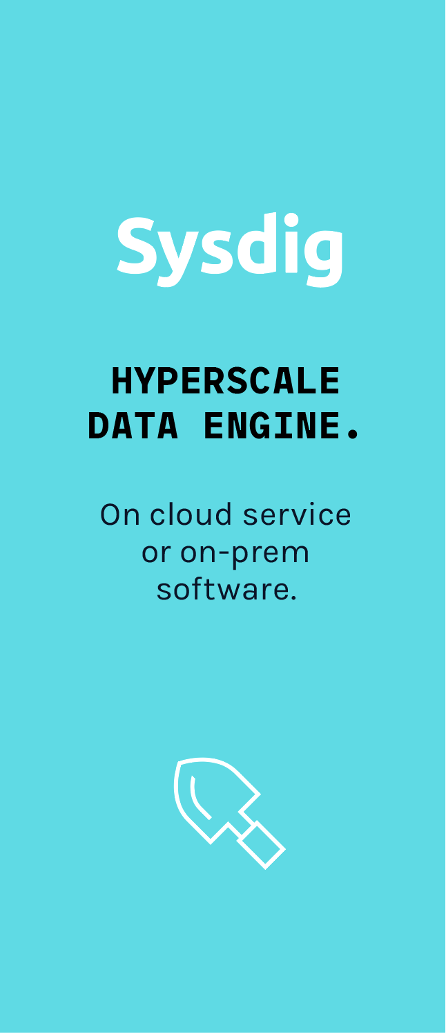
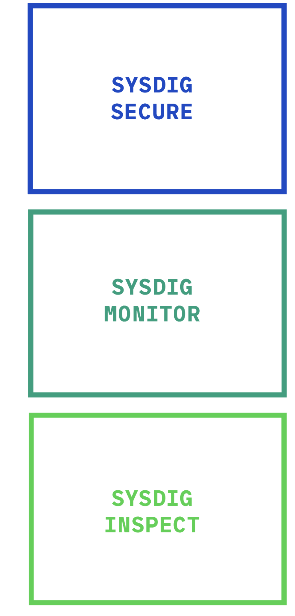
Cloud-native visibility + security platform.
ARCHITECTURE
IN-DEPTH, CONTEXTUAL DATA
ENTERPRISE SCALE + MANAGEMENT
THE RIGHT DATA + WORKFLOW – PER TEAM

Slide 13
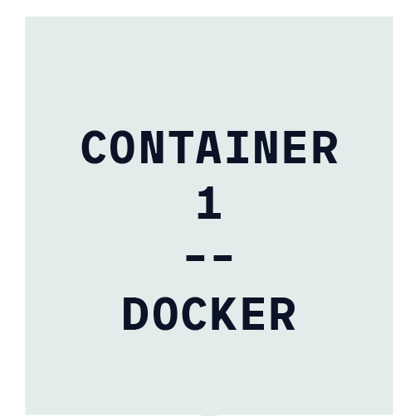
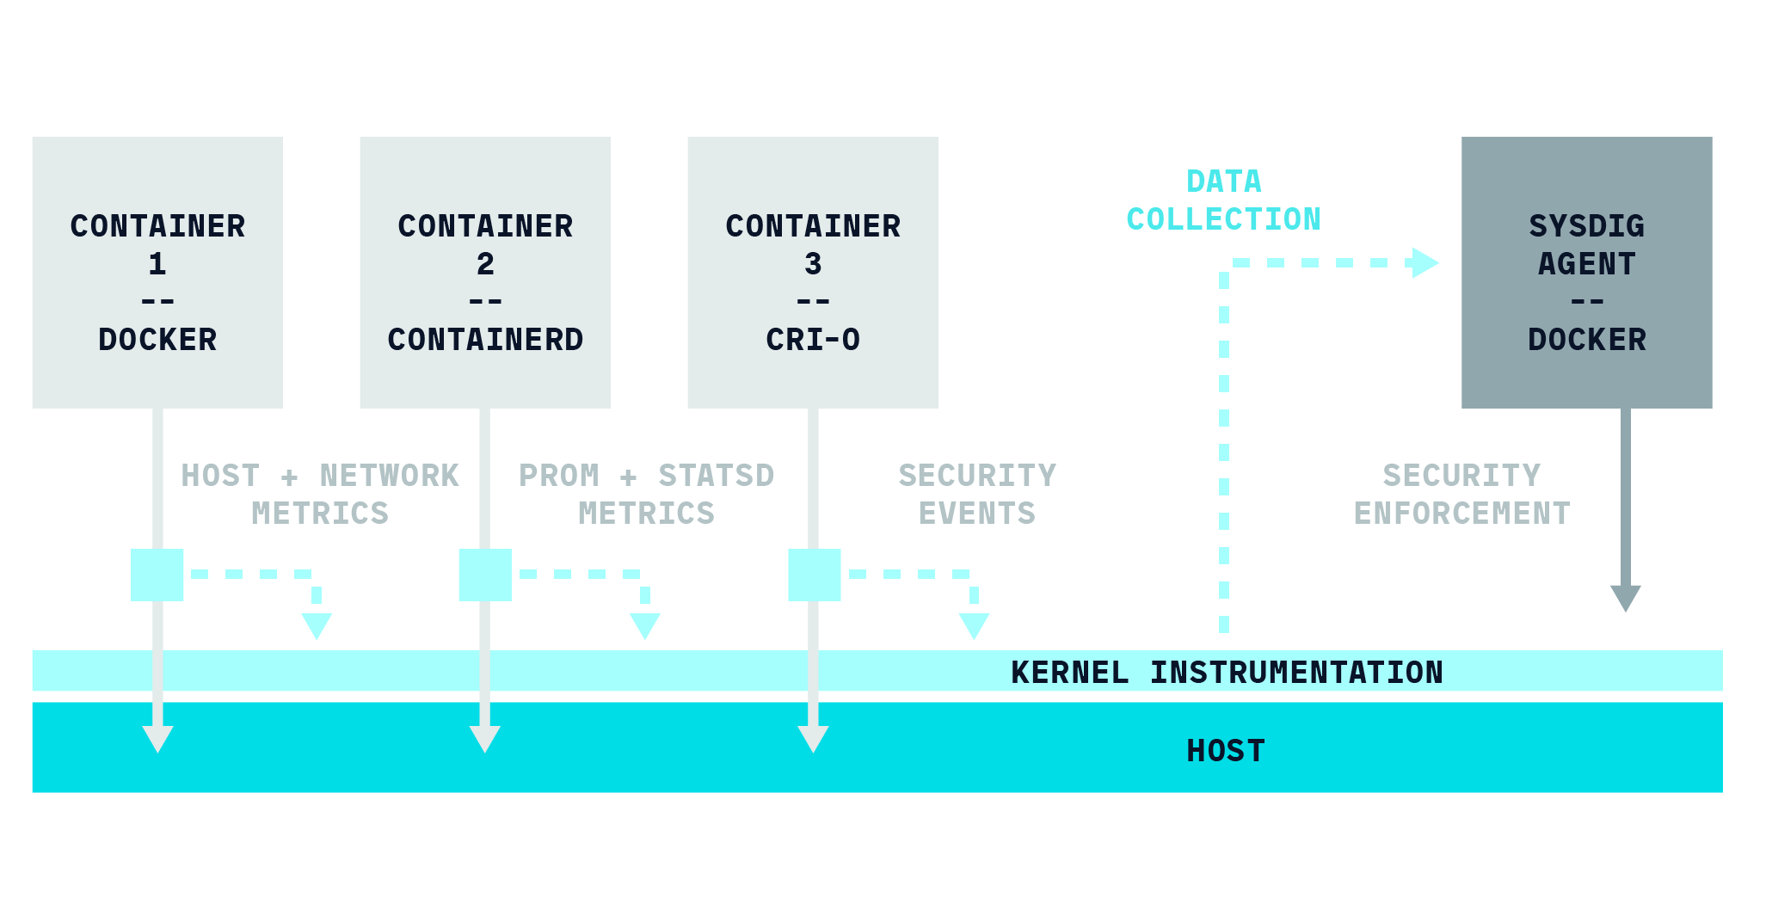

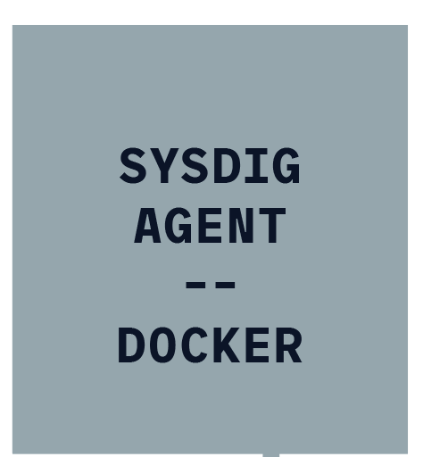
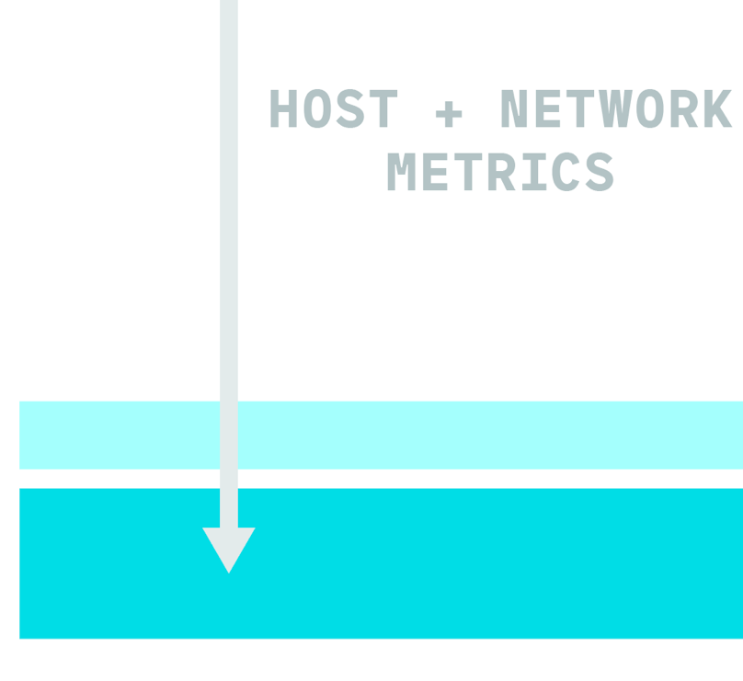
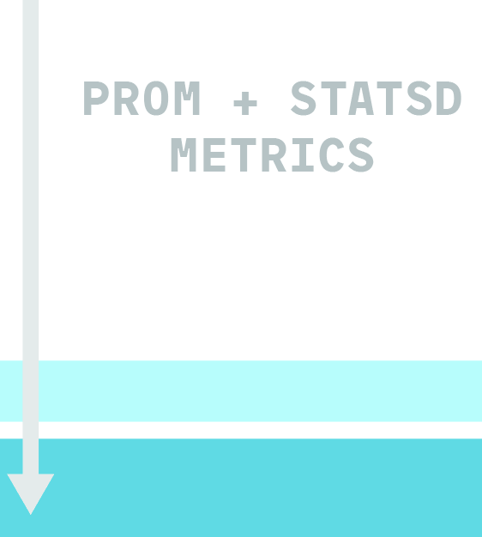
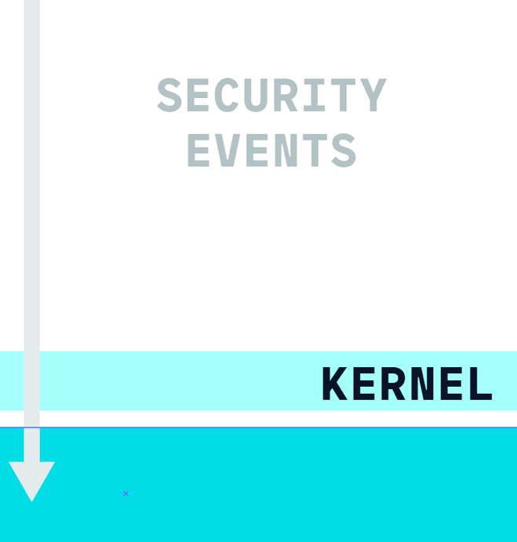
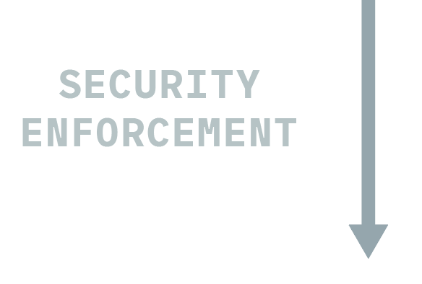





Microservice oriented instrumentation.
SYSDIG CONTAINERVISION™
Kernel Instrumentation or eBPF PROGRAM

Slide 14
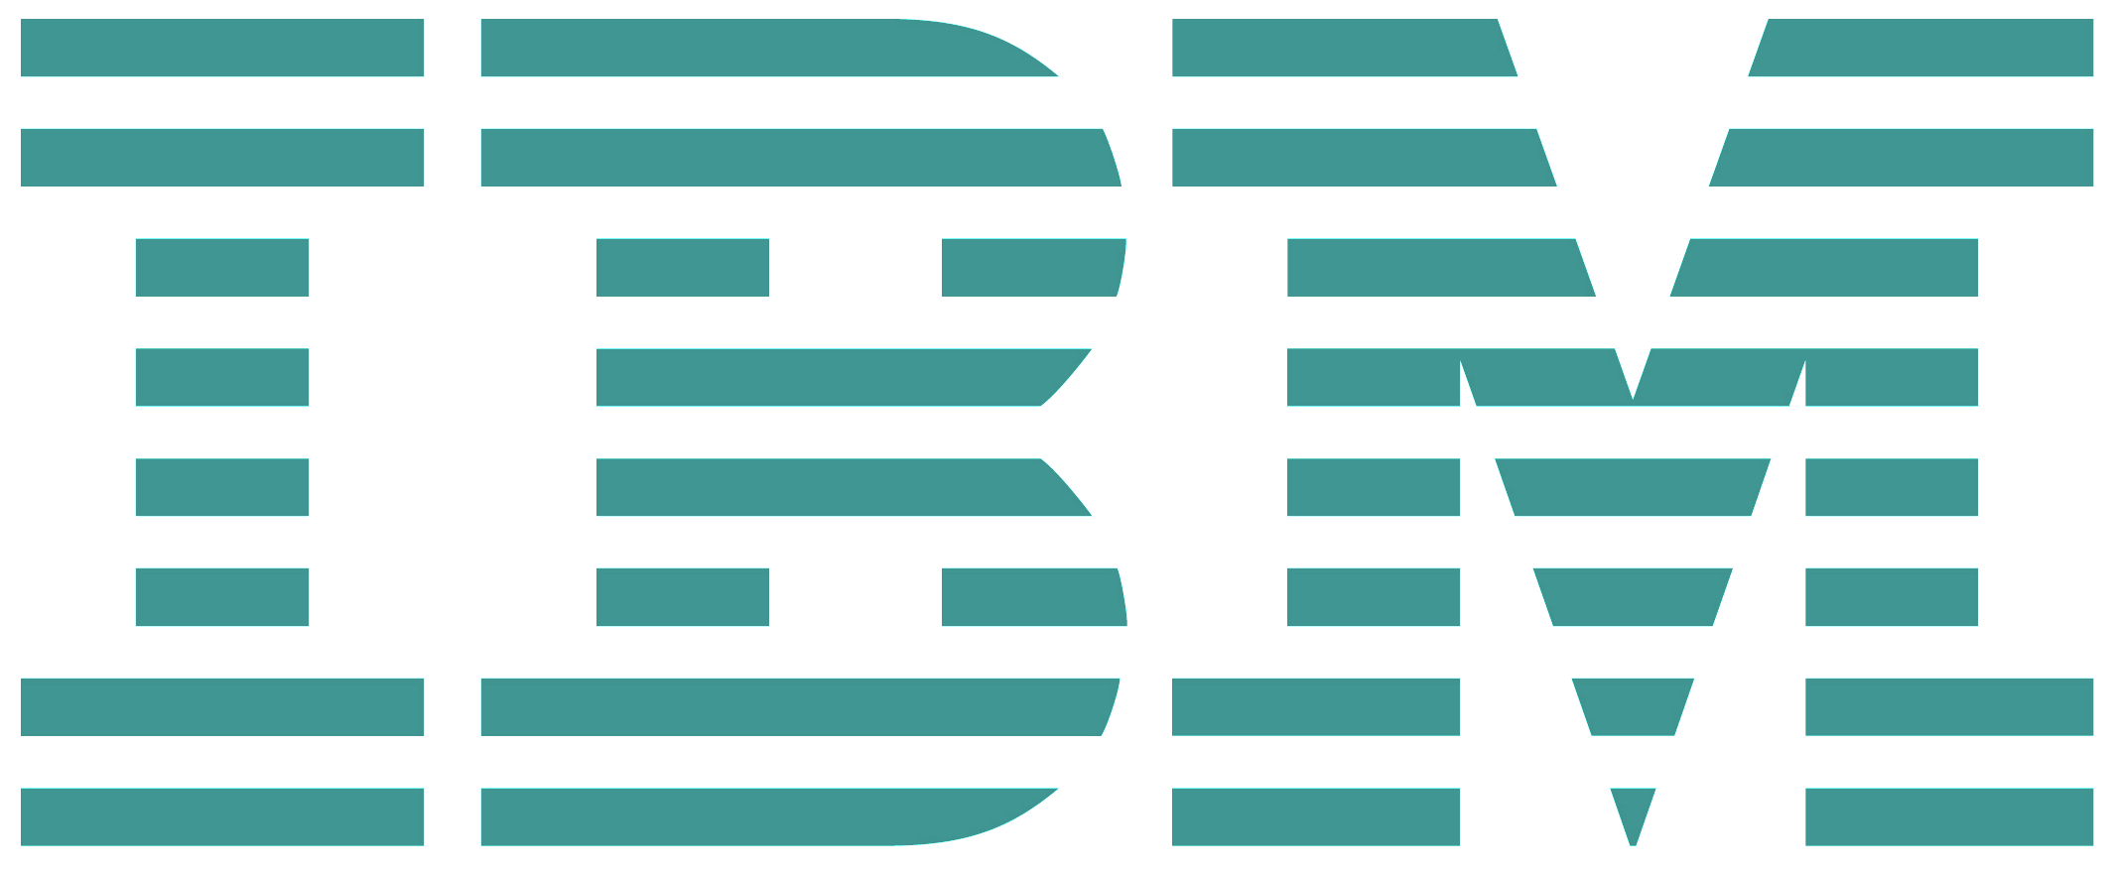
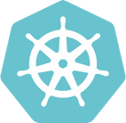
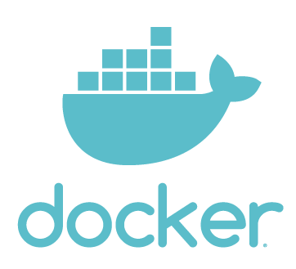

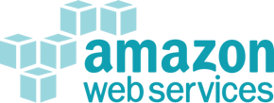

Making metrics relevant with context.
SYSDIG SERVICEVISION™
ServiceVisionTM
HOST
HOST
HOST
HOST
Sysdig ServiceVision enables metadata enrichment to make security enforcement and performance monitoring as dynamic as your cloud-native environment.
HOST
HOST
HOST
HOST
HOST
HOST
HOST
HOST
KUBERNETES
OPENSHIFT
IKS
DOCKER EE
DC/OS
AKS
GKE
AZURE
AWS
CUSTOM
… AND MORE!
HOST
HOST
HOST
HOST
Notes:
Relevance is incredibly important, arguably the most important part of all this. It’s almost pointless having a huge array of Observability data at your fingertips if there is no way to make sense of it. We tap into the metadata that you have already built into your applications by using cloud services, orchestrators or something else. This allows us to frame the telemetry and security data in a way that is uniquely relevant to different consumers.
The owner of the payments-processing platform doesn’t care that the HR system is having problems
The infrastructure team wants to see capacity information daily to ensure they are providing sufficient resources to the business
etc.

Slide 15

Making metrics relevant with context.
SYSDIG SERVICEVISION™
ServiceVisionTM
HOST
HOST
HOST
HOST
HOST
HOST
HOST
HOST
Application Team X
HOST
HOST
HOST
HOST
KUBERNETES
OPENSHIFT
IKS
DOCKER EE
DC/OS
AKS
GKE
AZURE
AWS
CUSTOM
… AND MORE!
HOST
HOST
HOST
HOST
Namespace = Application Team X
Notes:
Relevance is incredibly important, arguably the most important part of all this. It’s almost pointless having a huge array of Observability data at your fingertips if there is no way to make sense of it. We tap into the metadata that you have already built into your applications by using cloud services, orchestrators or something else. This allows us to frame the telemetry and security data in a way that is uniquely relevant to different consumers.
The owner of the payments-processing platform doesn’t care that the HR system is having problems
The infrastructure team wants to see capacity information daily to ensure they are providing sufficient resources to the business
etc.

Slide 16

Making metrics relevant with context.
SYSDIG SERVICEVISION™
ServiceVisionTM
HOST
HOST
HOST
HOST
HOST
HOST
HOST
HOST
HOST
HOST
HOST
HOST
KUBERNETES
OPENSHIFT
IKS
DOCKER EE
DC/OS
AKS
GKE
AZURE
AWS
CUSTOM
… AND MORE!
HOST
HOST
HOST
HOST
Deployment contains ‘db’
DB admin
Notes:
Relevance is incredibly important, arguably the most important part of all this. It’s almost pointless having a huge array of Observability data at your fingertips if there is no way to make sense of it. We tap into the metadata that you have already built into your applications by using cloud services, orchestrators or something else. This allows us to frame the telemetry and security data in a way that is uniquely relevant to different consumers.
The owner of the payments-processing platform doesn’t care that the HR system is having problems
The infrastructure team wants to see capacity information daily to ensure they are providing sufficient resources to the business
etc.

Slide 17
Making metrics relevant with context.
SYSDIG SERVICEVISION™
ServiceVisionTM
HOST
HOST
HOST
HOST
HOST
HOST
HOST
HOST
PCI-Regulated Application Team Y
HOST
HOST
HOST
HOST
KUBERNETES
OPENSHIFT
IKS
DOCKER EE
DC/OS
AKS
GKE
AZURE
AWS
CUSTOM
… AND MORE!
HOST
HOST
HOST
HOST
Project = Application Team Y
Notes:
Relevance is incredibly important, arguably the most important part of all this. It’s almost pointless having a huge array of Observability data at your fingertips if there is no way to make sense of it. We tap into the metadata that you have already built into your applications by using cloud services, orchestrators or something else. This allows us to frame the telemetry and security data in a way that is uniquely relevant to different consumers.
The owner of the payments-processing platform doesn’t care that the HR system is having problems
The infrastructure team wants to see capacity information daily to ensure they are providing sufficient resources to the business
etc.

Slide 18
Making metrics relevant with context.
SYSDIG SERVICEVISION™
ServiceVisionTM
HOST
HOST
HOST
HOST
HOST
HOST
HOST
HOST
HOST
HOST
HOST
HOST
HOST
HOST
HOST
HOST
HOST
HOST
KUBERNETES
OPENSHIFT
IKS
DOCKER EE
DC/OS
AKS
GKE
AZURE
AWS
CUSTOM
… AND MORE!
HOST
HOST
HOST
HOST
HOST
HOST
Host contains ‘production’
Infra admin

Slide 19
Making metrics relevant with context.
SYSDIG SERVICEVISION™
ServiceVisionTM
HOST
HOST
HOST
HOST
HOST
HOST
HOST
HOST
Better performance and security throughout the
container lifecycle
HOST
HOST
HOST
HOST
KUBERNETES
OPENSHIFT
IKS
DOCKER EE
DC/OS
AKS
GKE
AZURE
AWS
CUSTOM
… AND MORE!
HOST
HOST
HOST
HOST
Notes:
Relevance is incredibly important, arguably the most important part of all this. It’s almost pointless having a huge array of Observability data at your fingertips if there is no way to make sense of it. We tap into the metadata that you have already built into your applications by using cloud services, orchestrators or something else. This allows us to frame the telemetry and security data in a way that is uniquely relevant to different consumers.
The owner of the payments-processing platform doesn’t care that the HR system is having problems
The infrastructure team wants to see capacity information daily to ensure they are providing sufficient resources to the business
etc.

Slide 20




Sysdig Product Demo
BUILD
RUN
RESPOND
Image Scanning
Compliance
Dependency and Topology Mapping
Performance Monitoring
Run-time security
Anomaly detection
Troubleshooting
Forensics
Auditing
We’ll walk through your entire container lifecycle
and make each step reliable and secure.

Slide 21
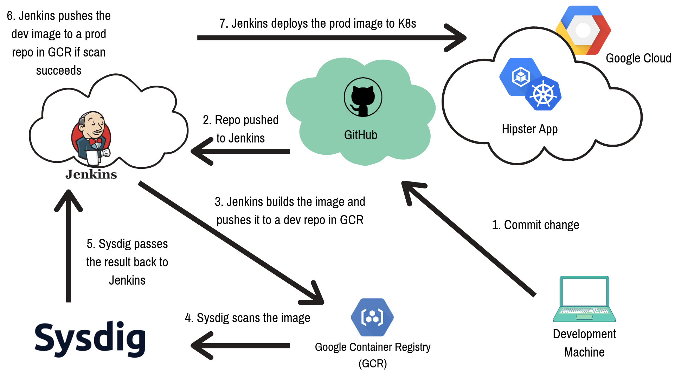
Demo1: CI/CD with scanning. (BUILD)
Demos
Hipster Shop:
Demo App
Add vulnerabilities to the frontend microservice
Expose port 22
Add a password env variable
Add a private key in a file

Slide 22
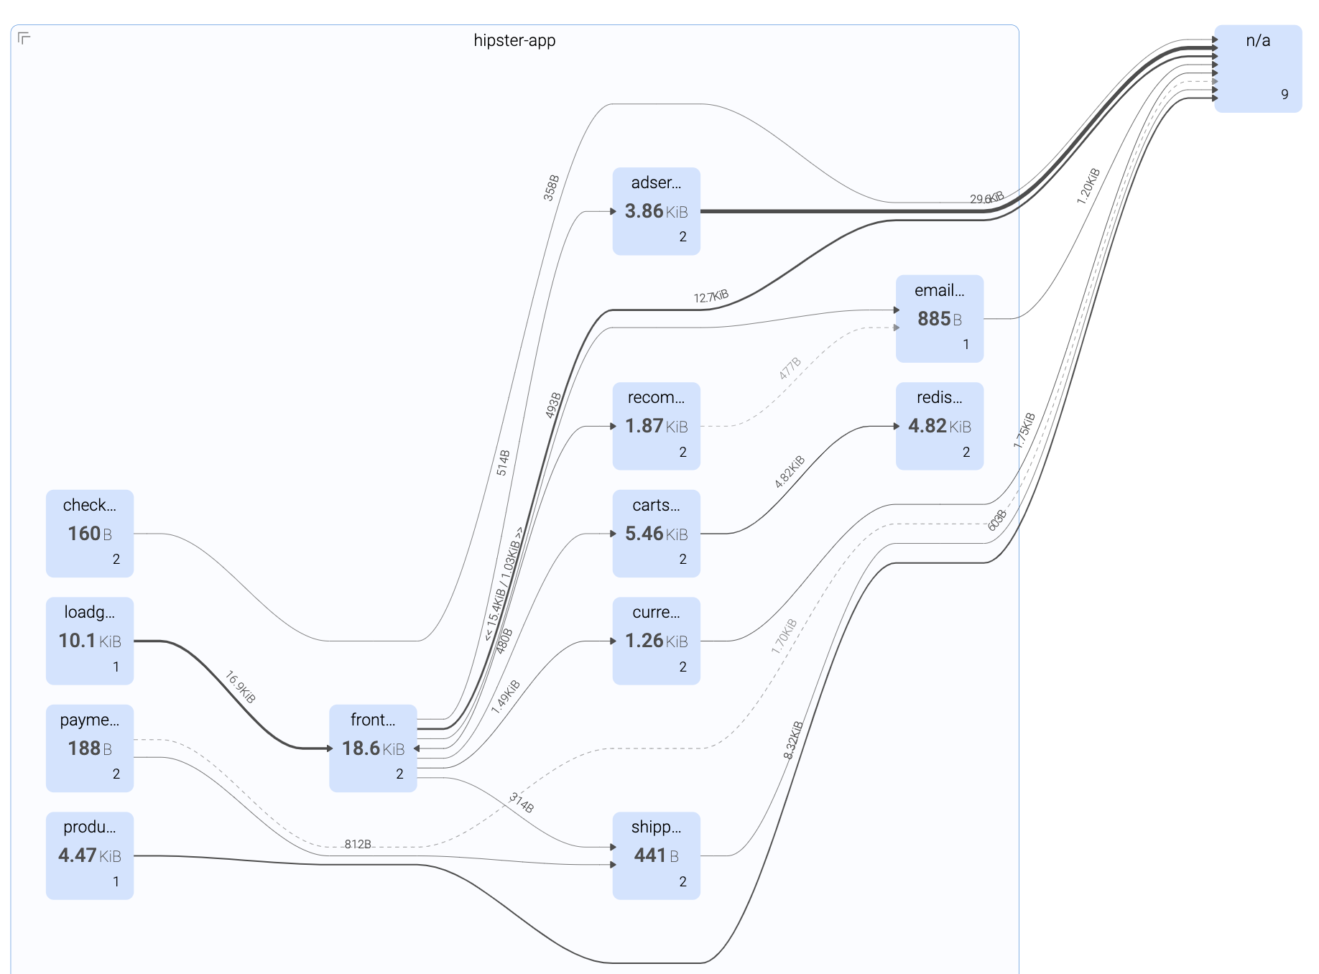
Demo2: Performance. (RUN)
Demos
Hipster Shop: Demo App
Delete the deployment checkoutservice to see the performance degradation in Response Time and Error Rate.
Check the capture file and go to HTTP Errors and drill in. Show the connection problem to the given IP and port.

Slide 23
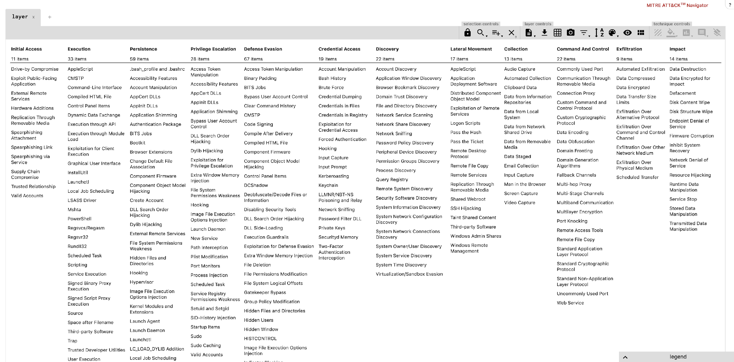
Demo3: Runtime Security. (RESPOND)
Demos
Privilege Escalation: Launch Privileged Container
Execution: Run a terminal shell in container
Discovery: Launch Suspicious Network Tool in Container
Credential Access: Search Private Keys or Passwords
Defense Evasion: Delete Bash History
Links:
MITRE ATT&CK Matrix
MITRE ATT&CK framework for container runtime security with Falco

